Slide 1
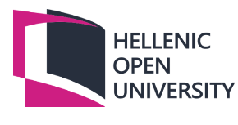
HELLENIC OPEN UNIVERSITY MASTER IN
BUSINESS ADMINISTRATION
Postgraduate Dissertation
The effect of the Greek economic crisis on oil companies listed on the
Greek stock exchange.
George Archontikis
Supervisor: Michail Bekiaris, Stergios Leventis

Slide 2
CONTENTS
-AIM
-INTRODUCTION
-Causes and consequences of the Greek economic crisis
-Impact of the crisis on financial stability and the operation of the stock market
-Brief presentation of the Major oil companies listed on the Greek stock exchange
-Connection between the performance of the companies and the Greek economic crisis. The case of ELPE.
-Financial performance indicators of oil companies
-Financial approach of Motoroil, Elinoil and ELPE companies
-Evaluation of the measures taken by the companies to deal with the consequences of the crisis
-Impact of the Greek economic crisis on cash flow generation and management.
-CONCLUSIONS

Slide 3
Causes and consequences of the Greek economic crisis
These factors can be categorized either as endogenous, related to the internal structure of the Greek economy, lingering macroeconomic imbalances and credibility issues surrounding macroeconomic policies, or as exogenous, arising from the effects of the recent financial turmoil and the response of Europe in the Greek fiscal crisis.
-The evolution of public debt in relation to political regimes and different governments in power reveals interesting patterns
-The lack of necessary fiscal consolidation over the last decade, combined with the constant misreporting of fiscal data, have undermined the credibility of the Greek government. The decline in competitiveness after joining the Economic and Monetary Union (EMU) further worsened the current account deficit. Maliaropoulos et al. 2010
-Payments for previous Greek bond issues are concentrated between 2010 and 2019, thus increasing the probability of a sovereign default during those years. Consequently, investors demanded higher and more volatile interest rates to lend money to Greece, as reflected in the widening of Greek spreads compared to German bonds. Maliaropoulos et al. 2010

Slide 4
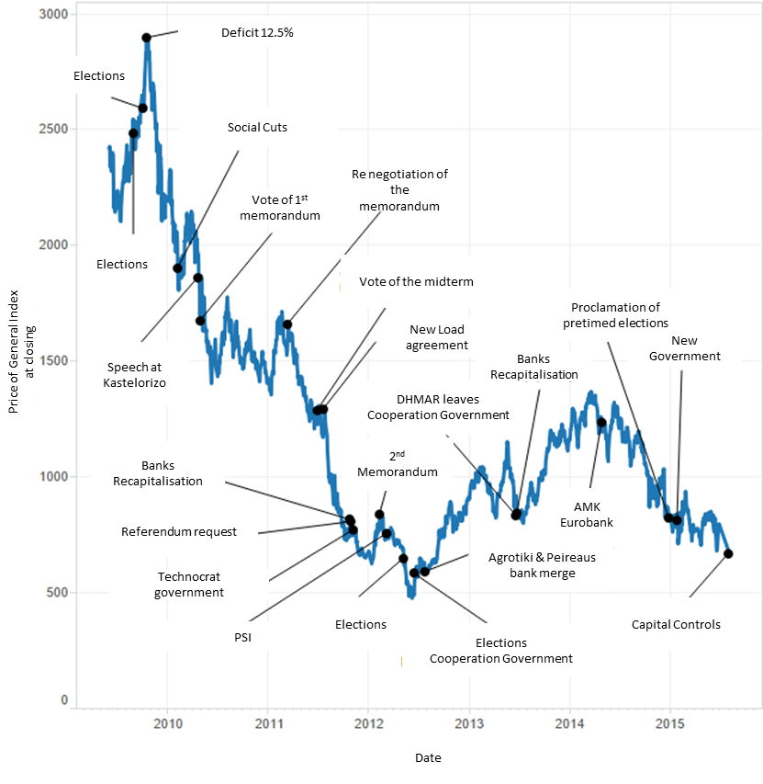
Impact of the crisis on financial stability and the
operation of the stock market
The financial crisis in Greece had deep and far-reaching effects on financial stability and the stock market.
Greece's economic and financial systems had deep-rooted weaknesses, leading to erosion of financial stability and disruption in the stock market.
Unsustainable public debt and lack of fiscal discipline eroded investor confidence and made it difficult for Greece to access international financial markets.
The Athens Stock Exchange experienced a severe recession, with plummeting stock prices and market capitalization.
Austerity measures and structural reforms aimed at restoring stability had negative consequences for the stock market, including declining consumer spending and lower corporate profitability.
Rescue programs by international creditors provided financial support but came with strict conditions and further restrictions.
Continued vigilance, structural reforms, fiscal discipline, and investor protection measures are crucial for Greece's economic recovery and stock market stability.
Lessons from the Greek crisis emphasize the importance of maintaining financial stability, strengthening regulatory frameworks, and promoting sustainable economic growth.
Learning from the crisis can help prevent similar financial turmoil and ensure the smooth functioning of financial markets in the future.
Comprehensive and prudent financial policies are vital for long-term health and stability of the stock market in Greece and beyond.

Slide 5
Brief presentation of the Major oil companies listed
on the Greek stock exchange
Hellenic Petroleum (ELPE):
-Hellenic Petroleum is the largest oil company in Greece and is listed on the Athens Stock Exchange.
-It is involved in all sectors of the oil and gas industry, including exploration, production, refining, and marketing.
-Hellenic Petroleum also has international operations and is engaged in oil and gas exploration
Motor Oil Hellas (MOH):
-Motor Oil Hellas is another significant oil company listed on the Greek stock exchange.
-The company is primarily involved in refining and marketing petroleum products.
-Motor Oil Hellas operates a major refinery in Greece and is a key player in the Greek downstream oil sector.
-The company also has subsidiaries involved in shipping and renewable energy.

Slide 6
Connection between the performance of the companies
and the Greek economic crisis.
The oil sector in Greece is greatly influenced by international economic and political factors, such as:
• The overall balance of payments, as oil sector products dominate the energy sector balance.
• The operation of industries, transport, the army and the efficient supply of all regions of Greece, especially the mountainous and island regions.
• Price manipulation, as the cost of goods and services depends on the volatility of oil prices.
• The direct economic impact on households, as oil is used for heating and transport.
• National defence, which requires adequate reserves of fossil fuels in times of crisis.
After the deregulation of the energy market and the implementation of European Union policies, the Greek oil sector is increasingly influenced by European energy policies, which set the framework for Greece's position in the international energy market. The emergence of new companies in the energy market, mergers and acquisitions between existing companies and increased investments in renewable sources characterize the evolving competitive landscape. The Greek oil market is structured with four refineries and about 50 companies involved in the trading of oil products.

Slide 7
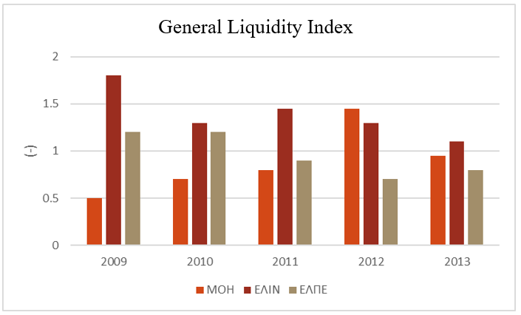
Financial approach of Motoroil, Elinoil and ELPE companies
The presented indexes are for five years, due to data availability.
ELINOIL SA consistently maintained a liquidity ratio above 1, reflecting effective management of short-term obligations.
MOTOR OIL SA had varied liquidity performance, covering short-term obligations in some years but struggling in others.
HELLENIC PETROLEUM SA had concerning liquidity results, with short-term liabilities not adequately covered by receivables and assets.
Enhanced liquidity management strategies are needed for both MOTOR OIL SA and HELLENIC PETROLEUM SA.
ELINOIL SA demonstrated the most successful liquidity management.
Effective measures to improve liquidity positions are crucial for financial stability and operational continuity.
Liquidity management is particularly important for oil companies during economic uncertainty or crisis.

Slide 8
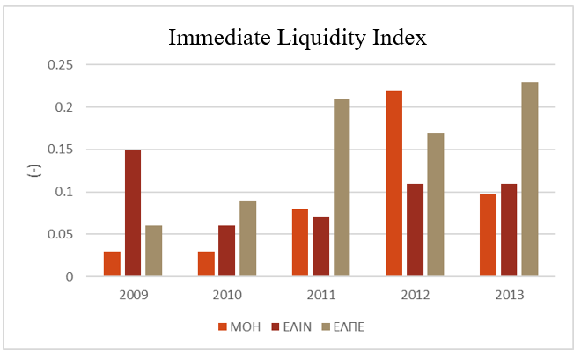
Financial approach of Motoroil, Elinoil and ELPE companies
HELLENIC PETROLEUM SA has the highest coverage ratio of short-term liabilities at 23%.
The other two companies have ratios of 10% and 11% in 2013.
Higher liquidity ratio implies better ability to meet short-term obligations and indicates stronger liquidity management.
Optimal liquidity ratio may vary by industry and business context.
Maintaining a healthy liquidity position is crucial for dealing with unforeseen circumstances and instilling confidence.
HELLENIC PETROLEUM SA's high liquidity ratio indicates relatively stronger ability to meet short-term obligations.
Other companies should focus on effective liquidity management strategies to enhance financial flexibility.
Optimizing liquidity positions improves operational resilience in challenging economic environments.

Slide 9
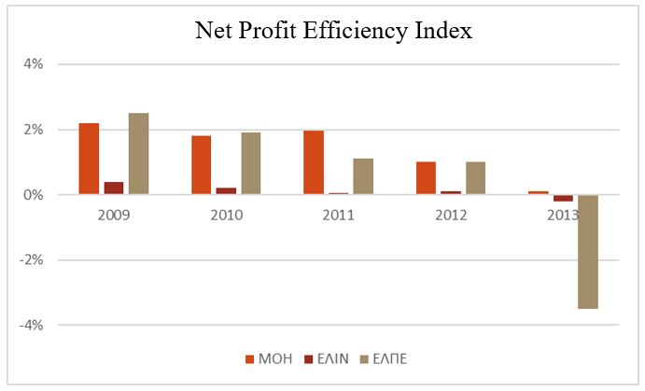
Financial approach of Motoroil, Elinoil and ELPE companies
MOTOR OIL SA had the highest net profit margin in 2013, but it decreased significantly from 2009.
ELINOIL S.A. and Hellenic Petroleum SA had negative net profit margins in 2013, indicating operational losses.
The decline in net profit margins highlights the challenges of competition faced by the companies.
Strategic measures to improve profitability and cost management are necessary.
This includes optimizing operations, exploring new revenue streams, and adopting effective pricing strategies.
Market dynamics and consumer behavior analysis are crucial for informed pricing decisions.
Net profit margin should be evaluated alongside other ratios for a comprehensive financial performance assessment.
Companies can pursue sustainable profitability by identifying areas for improvement and implementing targeted strategies.
Declining net profit margins emphasize the need for strategic measures in a competitive market.
By monitoring and analyzing net profit margin alongside other metrics, companies can adjust their business models, improve efficiency, and achieve long-term profitability.

Slide 10
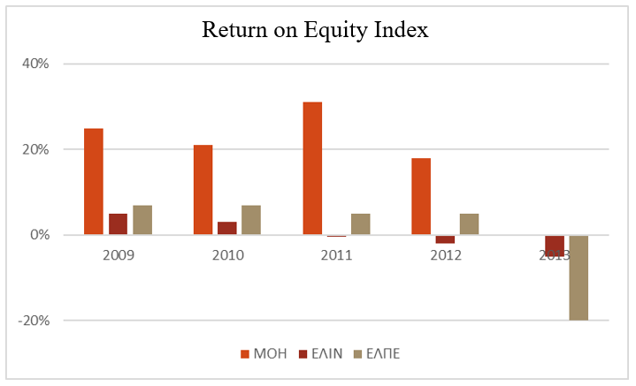
Financial approach of Motoroil, Elinoil and ELPE companies
The three companies under review have experienced a significant decline in their ROE ratios.
MOTOR OIL SA had the highest ROE of 1.26% in 2013, but it decreased from 25.51% in 2009, indicating a shift in financial performance.
ELINOIL S.A. and Hellenic Petroleum SA. had negative ROE indicators in 2013, suggesting net losses exceeding returns on equity investments.
Factors contributing to the decline in ROE could include increased operating costs, market dynamics, competition, or strategic shifts.
To improve ROE, companies should consider cost optimization, streamlining operations, exploring new markets, enhancing marketing and sales efforts, and identifying operational synergies.
Effective financial management practices, prudent capital allocation, debt optimization, and working capital monitoring can also improve ROE.
Analyzing ROE alongside other financial ratios like net profit margin, turnover ratio, and financial leverage provides a comprehensive understanding of financial health.
Decreasing ROE indicators highlight the challenges in using equity capital effectively and generating satisfactory returns.
Thorough analysis of underlying factors and strategic initiatives can improve ROE ratios and overall financial health.
This includes optimizing operational efficiency, exploring growth opportunities, managing costs, and ensuring a stable financial base.

Slide 11
Impact of the Greek economic crisis on cash flow
generation and management
Declining Demand: The economic crisis led to a sharp decline in consumer spending and overall economic activity. As a result, the demand for petroleum products, including gasoline and diesel, significantly contracted. This decline in demand had a direct impact on the cash flow of oil companies operating in Greece. For example, a major oil company experienced a 20% reduction in sales volumes of petroleum products during the peak of the crisis, resulting in a considerable decline in revenue and cash flow generation.
Price Volatility: The Greek economic crisis heightened volatility in global oil markets. Uncertainty surrounding the stability of the euro and concerns over Greece's ability to meet its financial obligations contributed to fluctuations in oil prices.

Slide 12
Impact of the Greek economic crisis on cash flow
generation and management
Currency Devaluation: The crisis resulted in the devaluation of the Greek currency, the euro, against major currencies like the US dollar. This devaluation had a substantial impact on the oil sector, particularly in terms of higher costs for importing crude oil and petroleum products.
Government Policies and Taxes: To tackle the economic crisis, the Greek government implemented austerity measures and introduced new taxes. The oil sector faced increased taxation and regulatory changes, such as higher excise taxes on petroleum products.
In general the companies as well as the sector increased their profits and liquidity despite the crisis challenges.

Slide 13
Thank you

Slide 14
Supporting Material

Slide 15
Financial performance indicators of oil companies
Revenue: Revenue is the total income generated by an oil company from its core operations, such as exploration, production, refining, and marketing. Consistent growth in revenue signifies increasing demand, effective market strategies, and successful business operations. It is a key indicator of the company's ability to capitalize on market opportunities and maintain a competitive position within the industry.
Net Income: Net income represents the company's profitability after deducting all expenses, including operating costs, taxes, and interest. Higher net income indicates efficient cost management, revenue growth, and the ability to generate profits. It demonstrates the company's ability to control expenses while maximizing revenue streams, providing a measure of financial success.
Gross Margin: Gross margin measures the percentage of revenue remaining after deducting the cost of goods sold (COGS). It provides insights into the efficiency of an oil company's operations and its ability to manage production costs. A higher gross margin suggests effective cost control and competitive pricing strategies. It highlights the company's ability to generate profit from each unit of production.
Operating Margin: Operating margin evaluates the profitability of a company's core operations by comparing operating income to revenue. It reflects the efficiency of cost management, productivity, and the ability to control operating expenses. A higher operating margin indicates better operational efficiency and profitability. It demonstrates the company's ability to generate profits before considering taxes, interest, and non-operating items.

Slide 16
Financial performance indicators of oil companies
5.Return on Equity (ROE): ROE measures the profitability of a company relative to the shareholders' equity invested in it. It indicates how effectively the company utilizes shareholders' investments to generate profits. A higher ROE suggests efficient capital allocation and solid financial performance. It is a key indicator for investors to assess the company's ability to generate returns on their investments.
6. Return on Assets (ROA): ROA assesses how efficiently a company utilizes its total assets to generate profits. It provides insights into the company's operational efficiency, asset management, and overall profitability. A higher ROA indicates effective asset utilization and strong financial performance. It helps evaluate the company's ability to generate income from its asset base.
7.Earnings per Share (EPS): EPS represents the portion of a company's net income allocated to each outstanding share of common stock. It provides a measure of profitability on a per-share basis and helps investors evaluate the company's earnings potential. Higher EPS indicates stronger profitability and potential returns for shareholders. It is a crucial metric for investors when considering investments in the company's stock.

Slide 17
Financial performance indicators of oil companies
9.Cash Flow from Operations: Cash flow from operations reflects the cash generated by an oil company's core business activities. Positive cash flow indicates the company's ability to generate cash from its operations, meet financial obligations, and fund future growth initiatives. It also provides a measure of financial stability and liquidity. It helps assess the company's ability to fund its ongoing operations and invest in future projects.
10.Debt-to-Equity Ratio: The debt-to-equity ratio compares a company's total debt to its shareholders' equity. It measures the proportion of capital financed through debt versus equity. A lower debt-to-equity ratio suggests a lower financial risk, strong solvency, and a better ability to withstand economic downturns. It provides insights into the company's capital structure and financial leverage.
11.Return on Investment (ROI): ROI calculates the return generated on an investment relative to its cost. In the oil industry, ROI helps evaluate the profitability of capital investments made in exploration, drilling, production, and infrastructure development. A higher ROI indicates successful investment decisions and potential for future growth. It is a critical metric for assessing the profitability of projects and capital allocation efficiency.

