Slide 1
Enhancing Smart Manufacturing through Data Analytics, Artificial Intelligence and Machine Learning:
The Impact and Integration of Industry 4.0 Technologies
MBA
Ραυτόπουλος Ανάργυρος
Μαματζάκης Εμμανουήλ
Ανδρουλάκης Γεώργιος Σ.
Notes:
"Good morning, and thank you for being here. My dissertation focuses on smart manufacturing and the integration of Industry 4.0 technologies. Today, I’ll present the core findings, case studies, and implications for both Greek and international industries."

Slide 2
Research Questions
The research is guided by a series of key questions that address both the technological and organizational dimensions of Industry 4.0.
Which fundamental technologies and tools are utilized in a Smart Factory and how do they function?
What are the competitive and strategic advantages of adopting smart manufacturing?
How can enterprises successfully transition to a Smart Factory environment?
What are the major challenges linked to the adoption of Industry 4.0 technologies?
To what extent is the Greek workforce prepared to adapt to the Smart Factory model?
Notes:
This research is guided by five core questions, focusing on the technologies that enable the smart factory, the strategic advantages they bring, the pathways for enterprises to transition, the challenges of adoption, and finally the readiness of the Greek workforce to embrace this transformation.

Slide 3
Methodology
The study combines theoretical analysis with applied case study research in order to explore the Smart Factory concept.
These companies were selected for their visibility in digital strategies, availability of performance data, and relevance across manufacturing sector.
Literature Review: Examination of academic sources and industry reports on Industry 4.0 and Smart Manufacturing.
Case Studies: Analysis of leading Greek and international companies (e.g., TITAN, Cenergy, Coca-Cola HBC, Mytilineos, Papastratos, PPC, EYDAP).
Comparative Approach: Identification of strategies, technologies, and measurable benefits across different sectors.
Focus on Workforce Readiness: Assessment of Greece’s human capital preparedness for Industry 4.0, based on secondary data and reports.
Notes:
"I combined theoretical analysis with applied case study research. I examined academic sources and industry reports, then analyzed seven major companies. The comparative approach allowed me to identify both technologies used and measurable benefits as well as workforce readiness."

Slide 4
Industry 4.0 Technologies (Part A)
Ιndustry 4.0 introduces advanced technologies that reshape production processes, decision-making, and supply chain management.
Artificial Intelligence (AI) & Machine Learning (ML): Enable predictive analysis, process optimization, and autonomous decision-making.
Big Data & Analytics: Transform large volumes of information into strategic insights for demand forecasting and quality control.
Internet of Things (IoT): Connects machines, devices, and people through sensors for real-time monitoring and communication.
Cloud Computing: Provides scalable data storage, remote access, and enhanced collaboration across production networks.
Notes:
“ Let’s Start with technologies, Industry 4.0 introduces data-driven technologies that reshape processes. AI and ML enable predictive analysis, Big Data turns information into insights, real time connectivity I achieved that to IoT and Cloud Computing allows remote storage and collaboration. Together, these form the technological foundation of digital transformation."

Slide 5
Industry 4.0 Technologies (Part Β)
Alongside data-driven tools, Industry 4.0 integrates advanced technologies that strengthen automation, security, and operational efficiency.
Robotics & Cobots: Support human workers by performing complex or repetitive tasks with precision and safety.
Augmented & Virtual Reality (AR/VR): Facilitate training, remote maintenance, and real-time guidance in complex operations.
Predictive Maintenance & Simulation: Anticipate equipment failures and test improvements through digital twins before real-world implementation.
Cybersecurity: Safeguards interconnected systems and sensitive data against growing digital threats.
Blockchain: Ensures transparency, traceability, and trust across the supply chain.
Notes:
"Alongside data-driven tools, automation technologies are also critical. Robotics and cobots are there to support workers, Augmented & Virtual Reality (AR/VR) helps with training and maintenance, predictive maintenance prevents downtime in production, while cybersecurity and blockchain ensure safety and transparency. These tools complement the digital backbone I described earlier."

Slide 6
Key Features of the Smart Factory (Part A)
Smart Factories reshape production by combining connectivity, intelligence, and real-time visibility.
Connectivity: Ensures continuous interaction between machines, people, sensors, and IT systems, enabling seamless data exchange across all levels of production.
Transparency & Visibility: Provides real-time insights into workflows, inventory, and machine performance, allowing for early detection of issues and informed decision-making.
Autonomous Decision-Making: With AI and ML, systems can independently adjust operations, optimize processes, and resolve problems without direct human intervention.
Predictive Capabilities: Large-scale data analysis enables forecasting of equipment failures, market demand, and supply chain disruptions before they occur.
Notes:
Thanks to the technologies mentioned above "Smart factories are defined by connectivity, transparency, autonomous decision-making, and predictive capabilities. This means machines, people, and systems are always connected, processes are visible in real time, decisions can be automated, and future issues can be anticipated before they disrupt operations."

Slide 7
Key Features of the Smart Factory (Part B)
Beyond automation, Smart Factories emphasize adaptability, efficiency, and collaboration.
Agility & Flexibility: Allow quick adaptation to fluctuating market conditions, product customization, and unexpected disruptions in production.
Resource Optimization & Energy Efficiency: Leverage advanced sensors and digital monitoring to minimize waste, optimize labor allocation, and reduce energy consumption.
Collaborative Integration: Foster strong cooperation between humans and machines through cobots, AR/VR tools, and interconnected enterprise systems.
Self-Organization & Learning: Enable factories to continuously improve by learning from their environment, adapting workflows, and evolving into dynamic, self-developing ecosystems.
Notes:
"Beyond automation, smart factories emphasize adaptability, efficiency, and collaboration. They adjust to changing markets, optimize resources, and use tools like cobots and AR/VR to support human–machine collaboration. Importantly, they can self-learn and improve continuously."

Slide 8
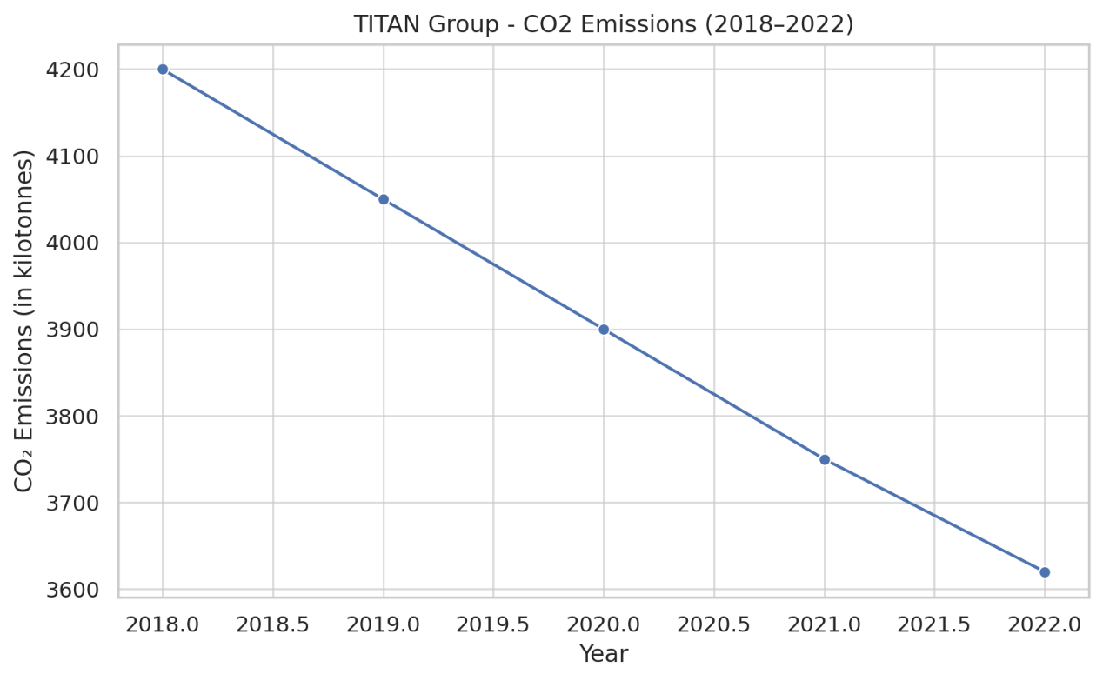
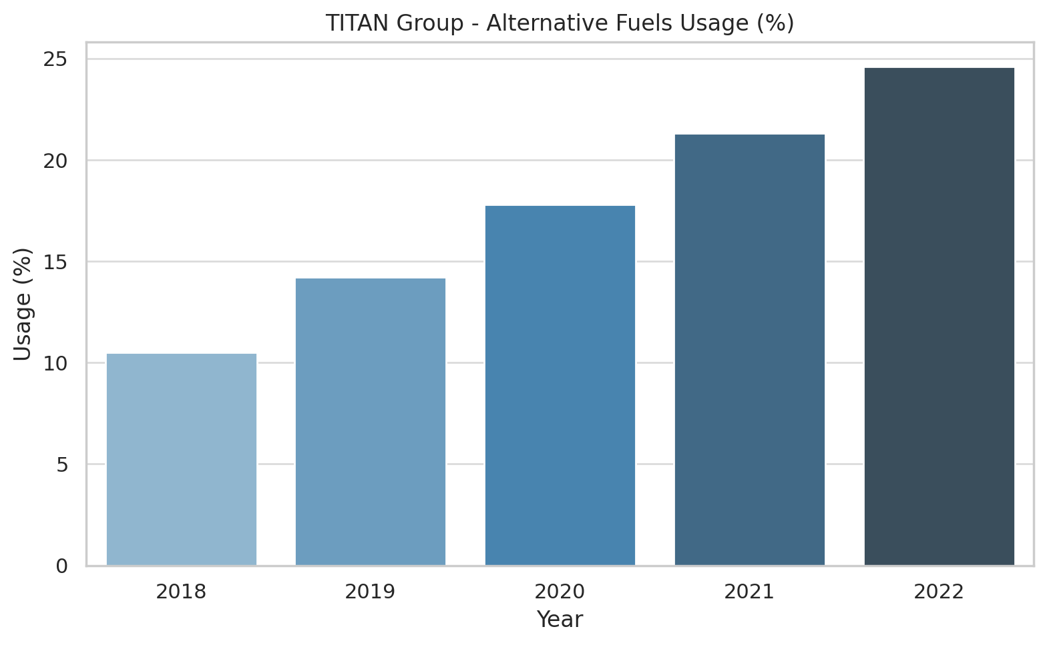
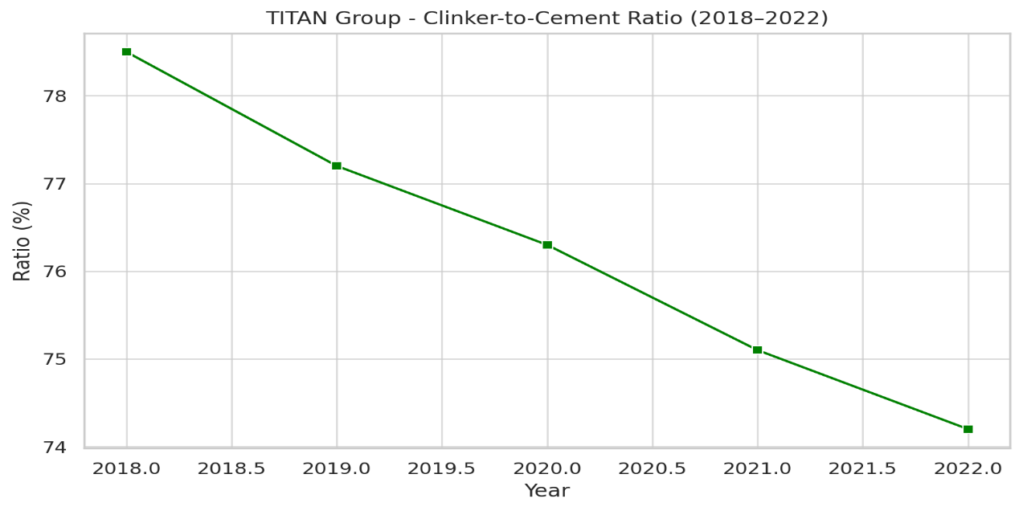
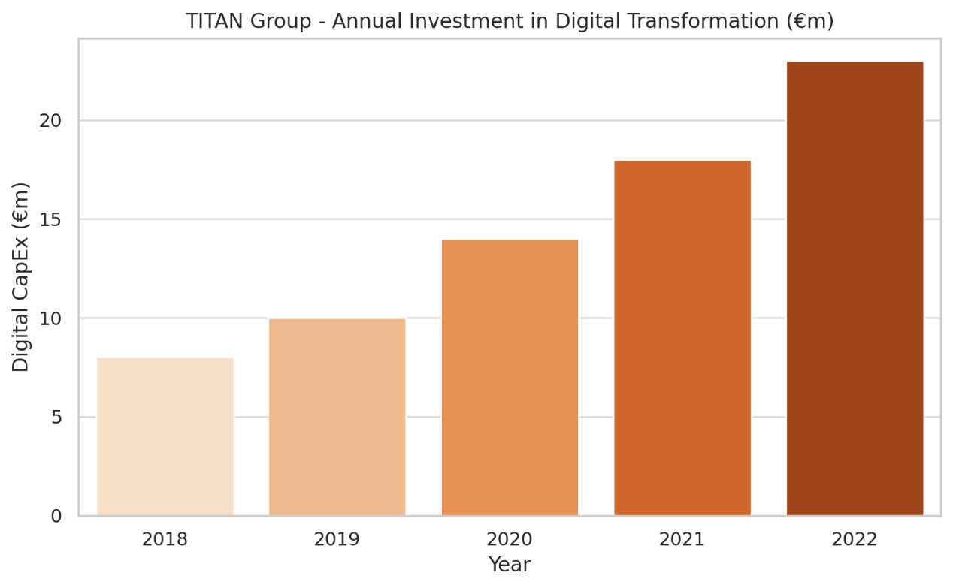
TITAN Group
TITAN Group has adopted digital twins, IoT sensors, and predictive maintenance across its production units, enabling real-time monitoring and optimization.
CO₂ Emissions (kt): A clear downward trend from 4,200 kt in 2018 to 3,620 kt in 2022, showing TITAN’s commitment to decarbonization.
Alternative Fuels Usage (%): Steady increase from 10.5% to 24.6%, reflecting progress in energy substitution.
Clinker-to-Cement Ratio (%): Continuous reduction from 78.5% to 74.2%, aligning with industry goals to reduce carbon intensity.
Digital Transformation Investment (€m): Annual digital CapEx has nearly tripled from €8M in 2018 to €23M in 2022.
Notes:
“Here we see the example of TITAN Group. The company reduced CO₂ emissions significantly, from 4,200 to 3,620 kilotons, while also increasing the use of alternative fuels and lowering the clinker-to-cement ratio. It has implemented IoT sensors, predictive maintenance, and digital twins across production, which improved efficiency and sustainability. Digital transformation investments also tripled in just four years, showing a strong commitment to innovation and green transition.”

Slide 9
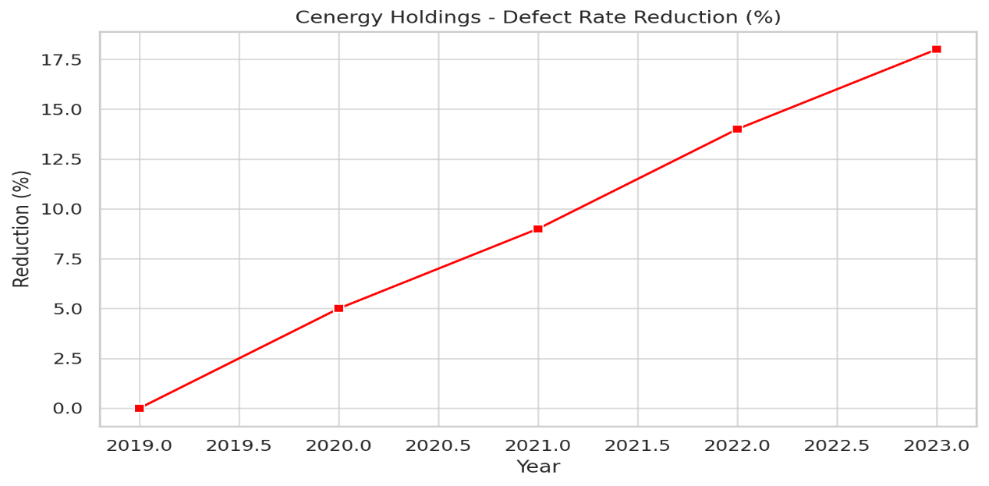
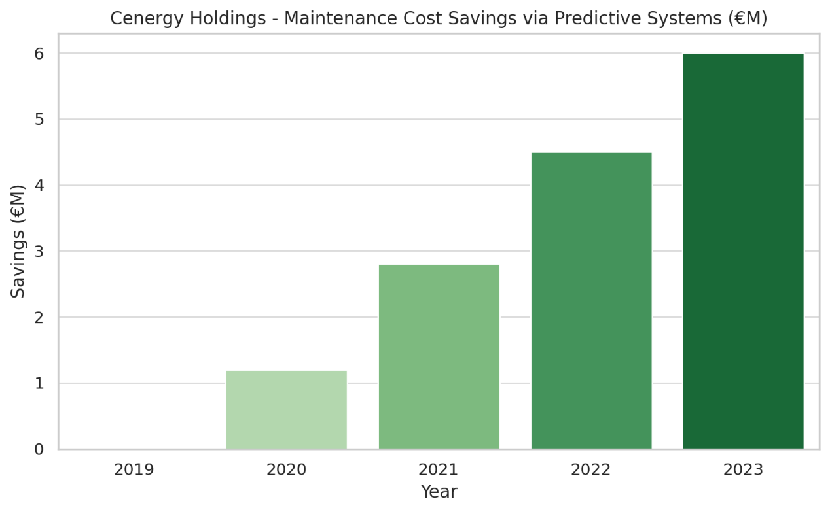
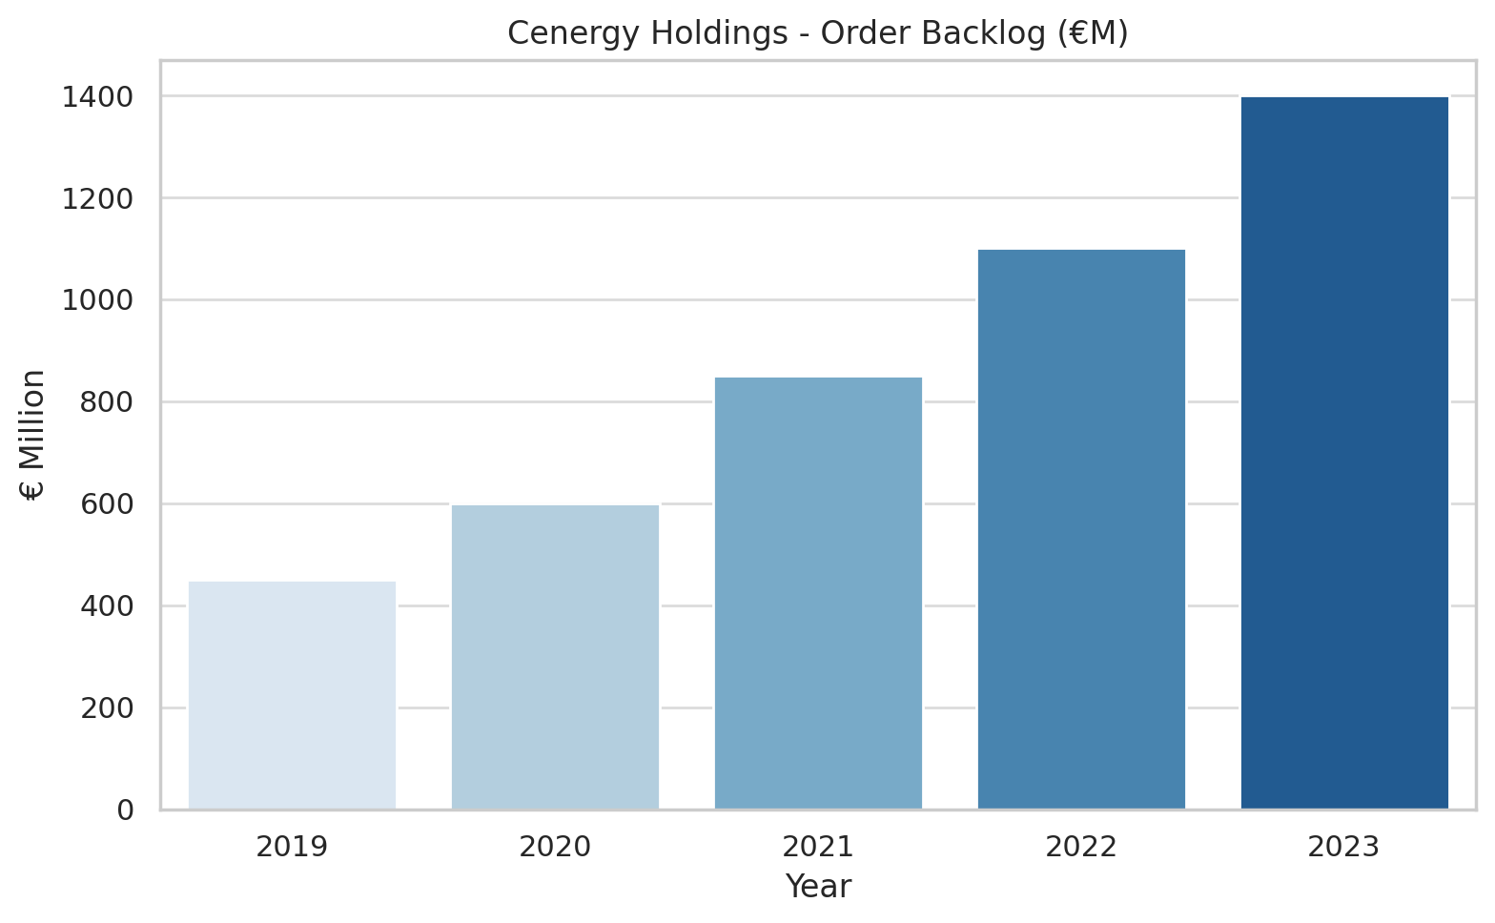
Cenergy Holdings
Cenergy Holdings has integrated IoT sensors, predictive maintenance, and real-time analytics systems, improving efficiency and reducing failures in cable and pipe production.
Defect Rate Reduction (%): Manufacturing defect rate dropped by 18% from 2019 to 2023
Predictive Maintenance Cost Savings (€M): Predictive maintenance systems saved €6M cumulatively by 2023.
Order Backlog (€M): Project backlog grew from €450M to €1.4B, reflecting strong demand across energy, subsea cables, and hydrogen sectors.
Notes:
“Cenergy Holdings, through Corinth Pipeworks and Hellenic Cables, integrated IoT, predictive maintenance, and real-time analytics. This helped reduce defect rates by 18%, saved six million euros in maintenance costs, and expanded its project backlog from 450 million to 1.4 billion euros. These results highlight how digital tools can simultaneously improve efficiency, lower costs, and strengthen market demand.”

Slide 10
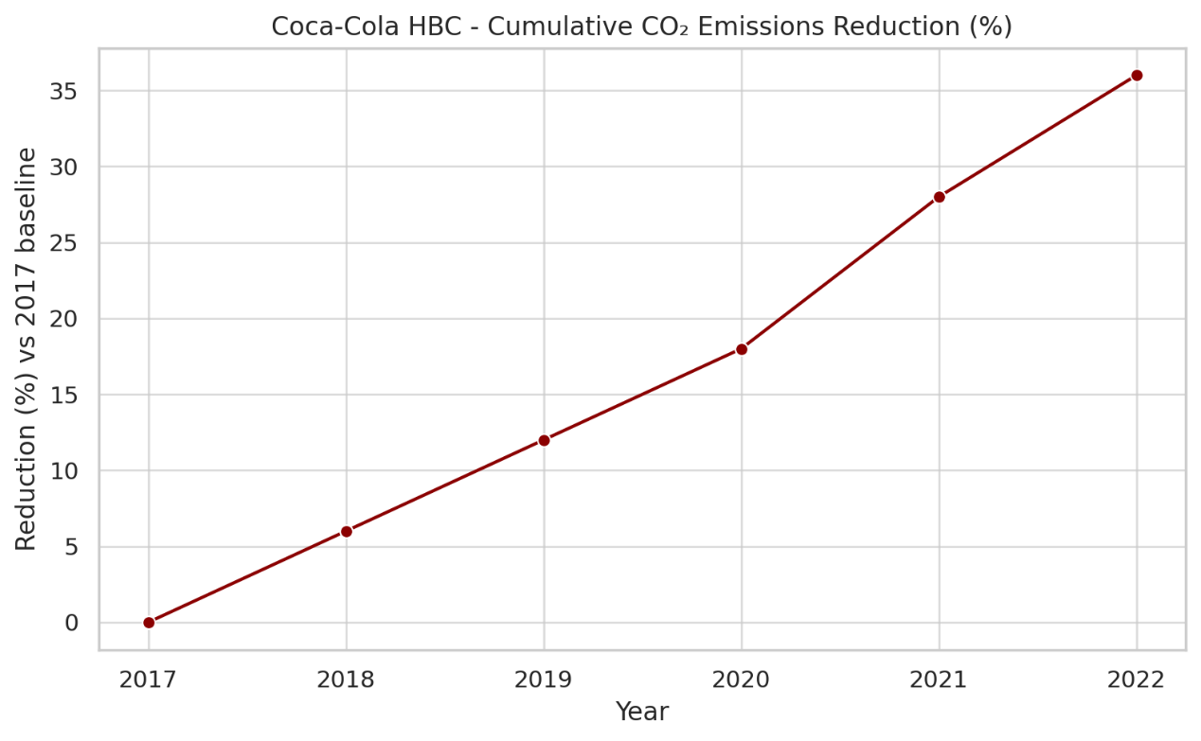
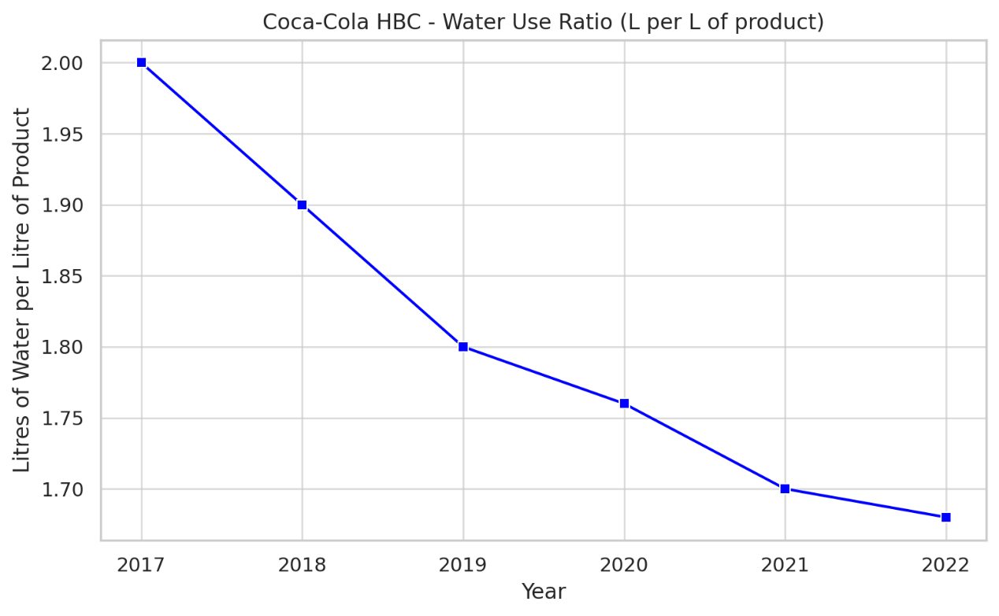
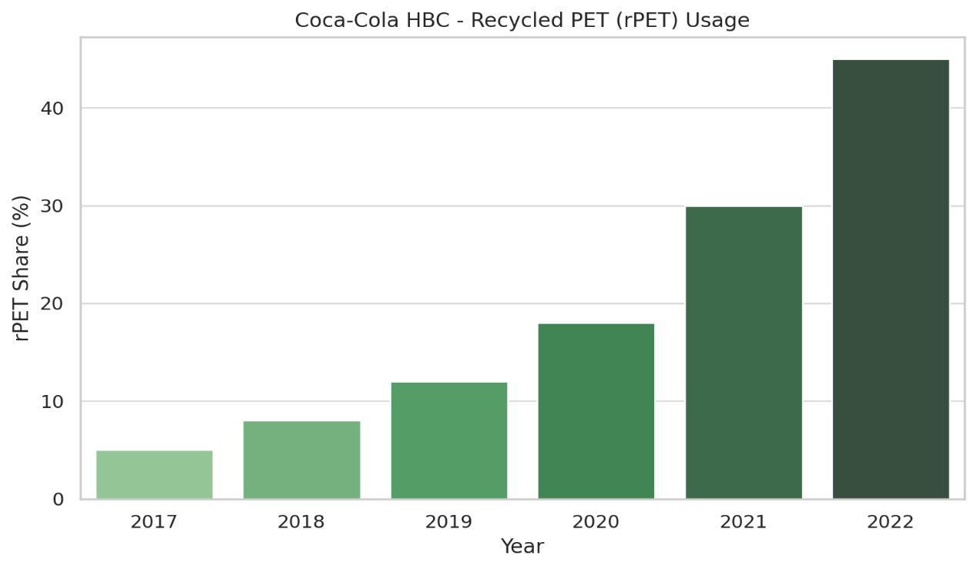
Coca-Cola HBC
Coca-Cola HBC, Edelstal plant in Austria pioneered digital twins, autonomous transport vehicles (LGVs), and voice-controlled smart glasses for logistics and warehousing.
CO₂ Emissions Reduction (% vs 2017 baseline): A cumulative drop reaching 36% by 2022 a strong indicator of sustainability progress.
Water Use Ratio: Improved efficiency from 2.0L to 1.68L per litre of product between 2017–2022.
rPET Usage (% in packaging): Increased sharply from 5% in 2017 to 45% in 2022, demonstrating a significant circular economy commitment.
Notes:
“Coca-Cola HBC is another strong example, with a 36% reduction in CO₂ emissions compared to its 2017 baseline. Water efficiency improved, and recycled PET in packaging rose from 5% to 45%. The Edelstal plant in Austria became a benchmark, using digital twins, autonomous guided vehicles, and smart glasses in logistics. These technologies supported both sustainability goals and operational innovation.”

Slide 11
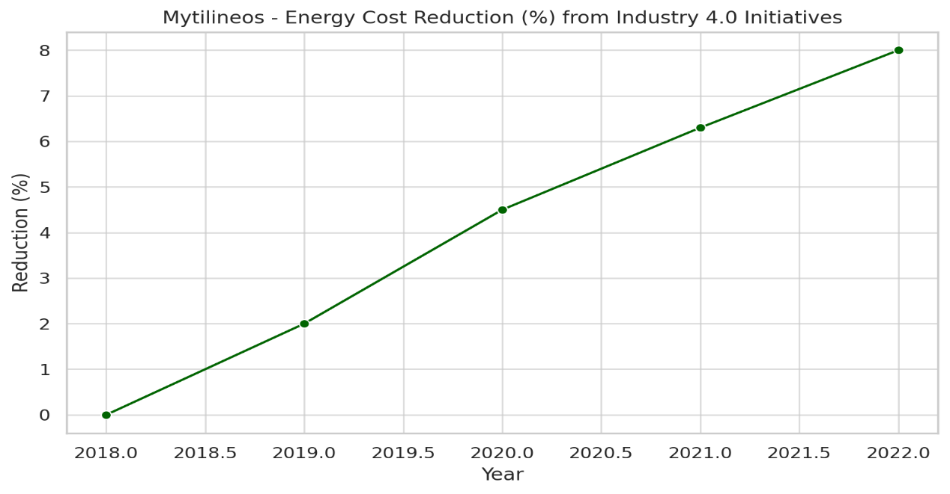
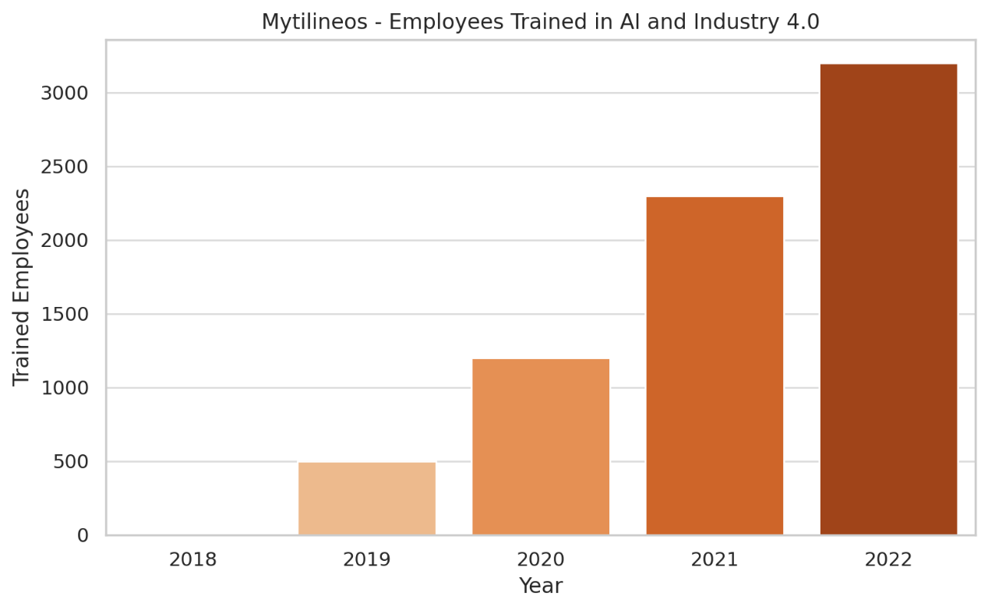
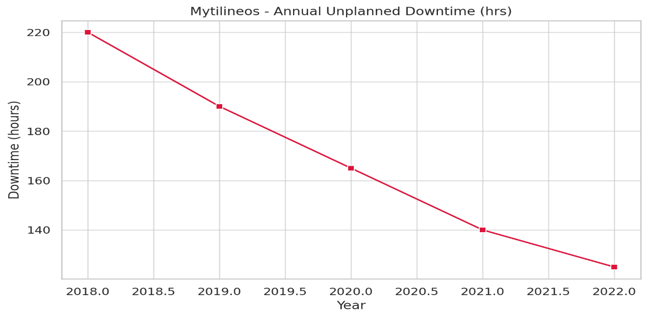
Mytilineos
Mytilineos integrated over 1,300 IoT sensors, predictive maintenance, and digital twins in its aluminium and energy operations
Energy Cost Reduction: Operational savings improved progressively, reaching an 8% reduction by 2022.
Employees Trained: 3,200 employees trained in AI and Industry 4.0 technologies by 2022, up from zero in 2018, demonstrating strong workforce transformation.
Unplanned Downtime: Dropped from 220 hours in 2018 to just 125 in 2022, thanks to predictive maintenance and IoT.
Notes:
“Mytilineos integrated over 1,300 IoT sensors, predictive maintenance, and digital twins across its aluminum and energy operations. As a result, unplanned downtime was reduced from 220 hours to just 125, and energy costs fell by 8%. At the same time, more than 3,200 employees were trained in AI and Industry 4.0 technologies, showing how workforce transformation is central to digital transition.”

Slide 12
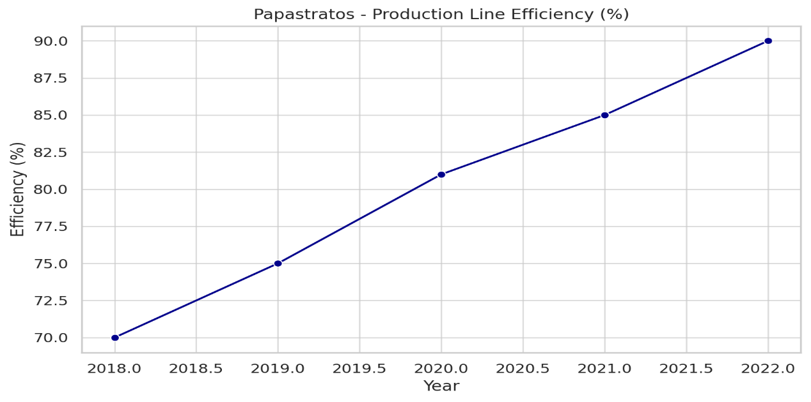
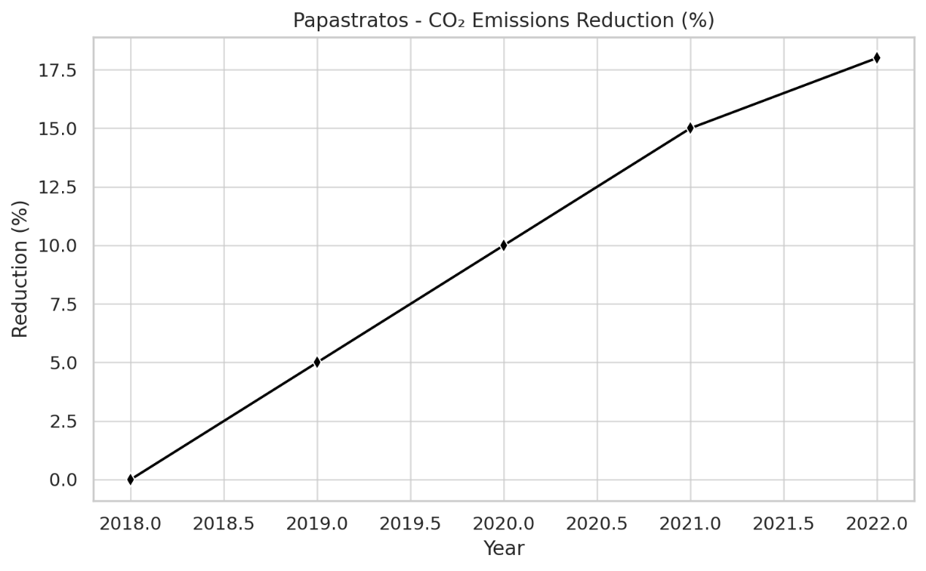
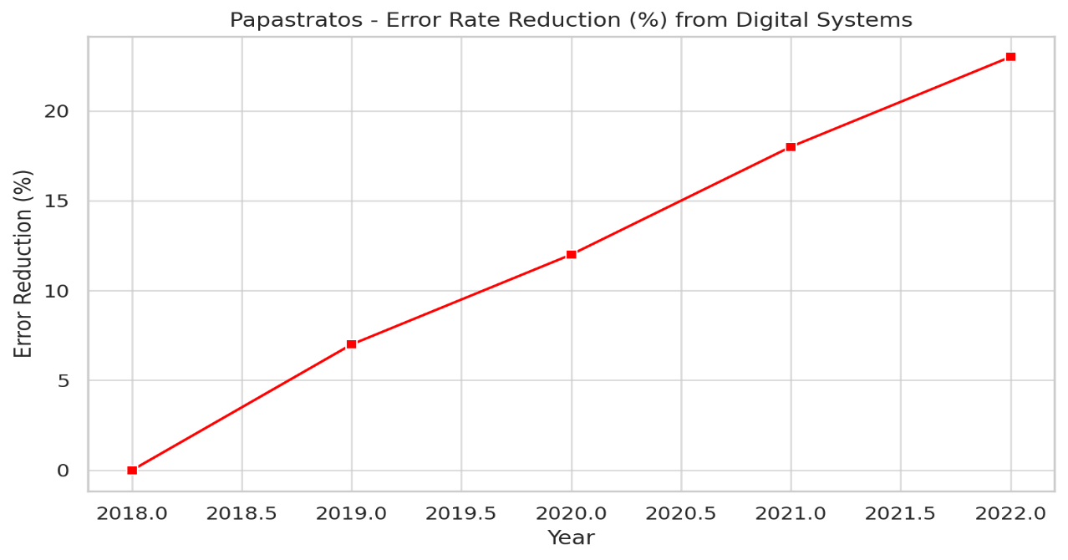
Papastratos (PMI)
Papastratos was recognized as a World Economic Forum Global Lighthouse Factory for its comprehensive Industry 4.0 integration.
Smart systems expanded from 5 to 65, doubling production capacity without increasing costs.
Production Efficiency: Increased significantly from 70% in 2018 to 90% in 2022, reflecting advanced automation.
Carbon Emissions Reduction: Achieved an 18% decrease in CO₂ emissions due to greener processes and real-time controls.
Error Reduction: Smart systems helped reduce production errors by 23% over five years.
Notes:
“Papastratos is one of the most recognized examples, officially named a Global Lighthouse Factory by the World Economic Forum. Production efficiency increased from 70% to 90%, CO₂ emissions dropped by 18%, and errors decreased by 23%. Smart systems expanded from just 5 to 65, doubling production capacity without raising costs. This makes Papastratos a clear model of comprehensive Industry 4.0 integration.”

Slide 13
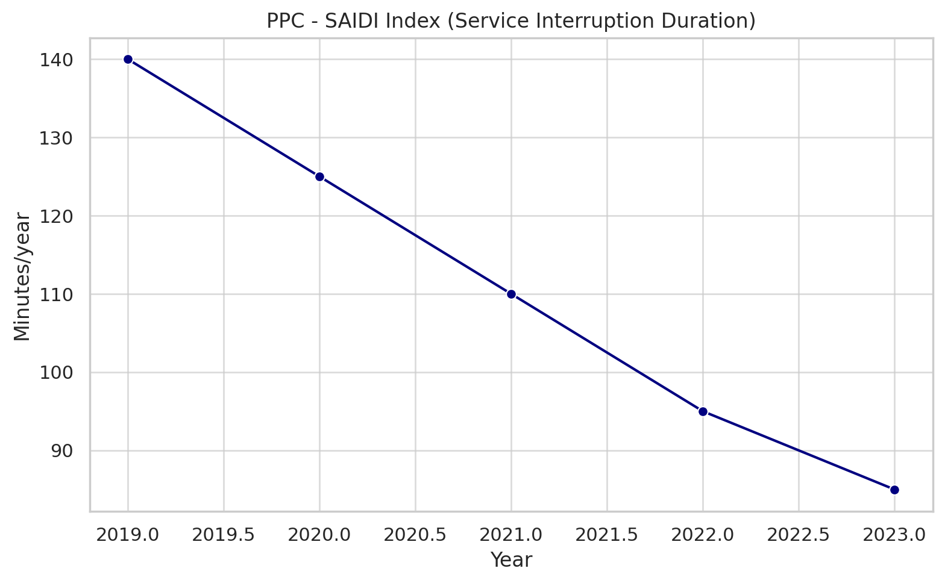
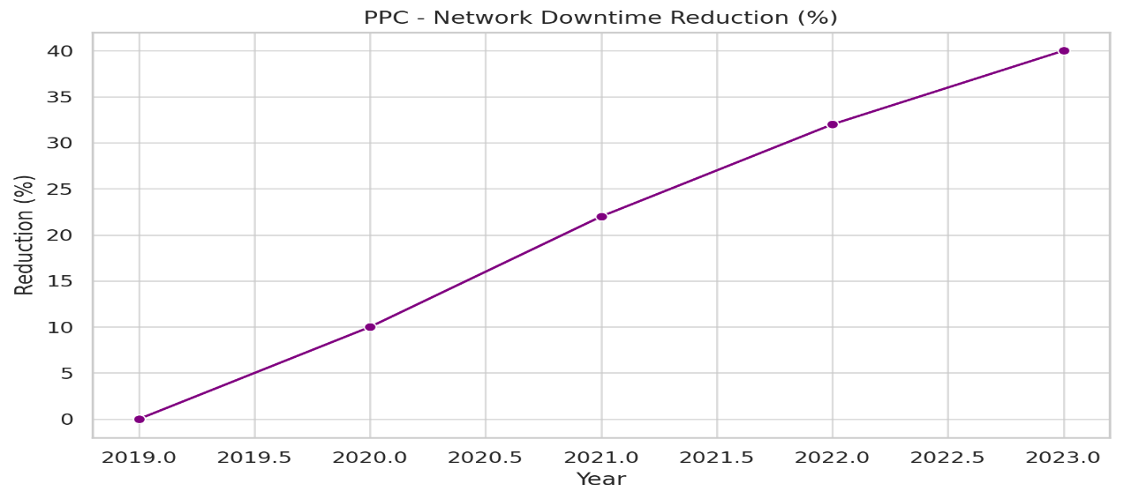
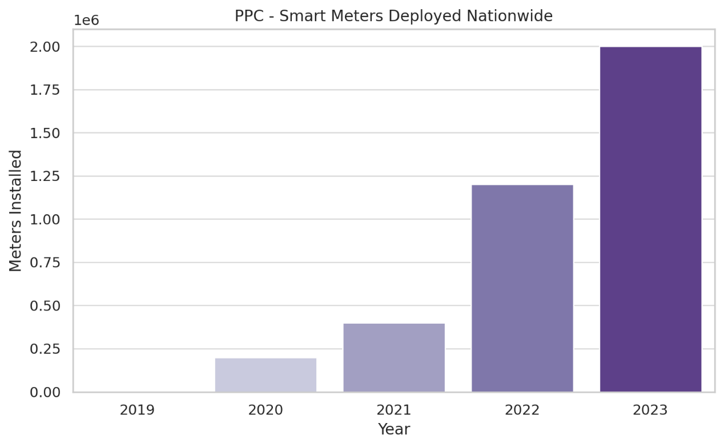
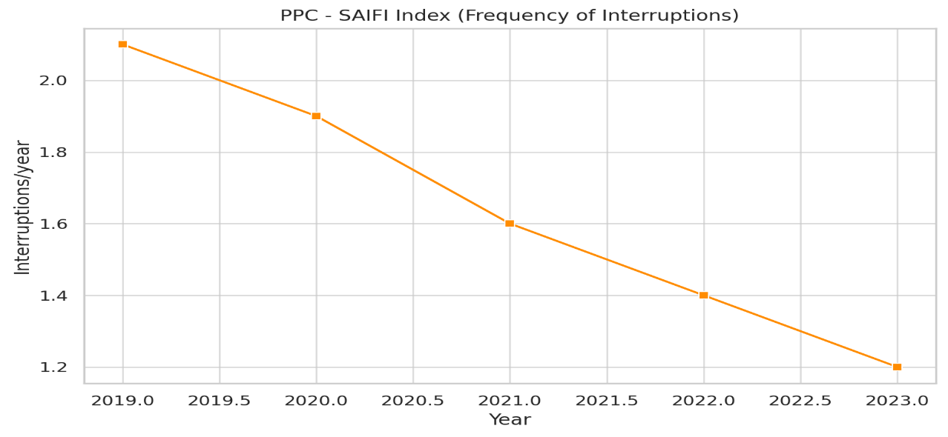
PPC (Public Power Corporation)
PPC (Public Power Corporation) invested €500M in smart grids, cloud computing, and predictive maintenance as part of its digital transition.
Downtime Reduction (%):PPC reduced network downtime by 40% between 2019 and 2023.
AVG Interruptions (Minutes per Year): Average duration of interruptions (SAIDI) fell from 140 mins/year to 85 mins/year.
Smart Meters Deployed: Smart meter installations expanded from 0 to 2 million in five years.
Interruptions per Year: Annual service interruptions per customer declined from 2.1 to 1.2.
Notes:
PPC invested heavily in digital transformation, with 500 million euros dedicated to smart grids, cloud computing, and predictive maintenance. Network downtime was reduced by 40%, interruptions fell sharply, and two million smart meters were installed. These steps not only improved service reliability but also marked a major step for digital modernization in Greece’s energy sector.”

Slide 14
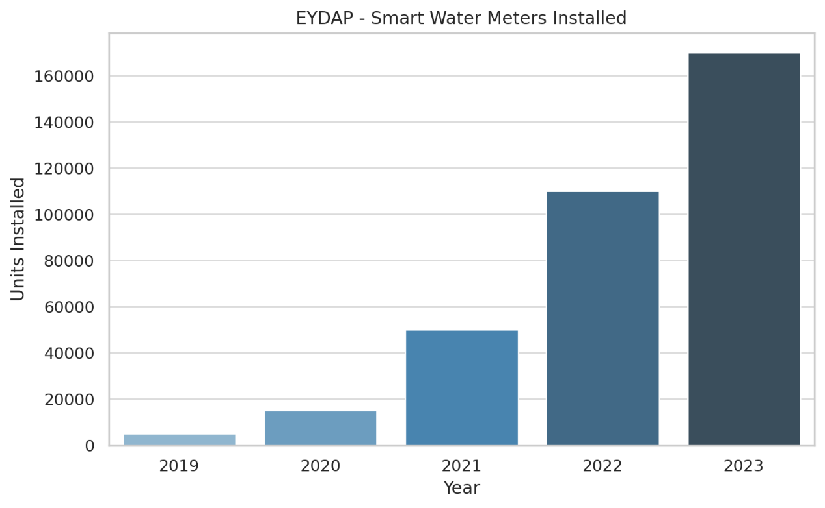
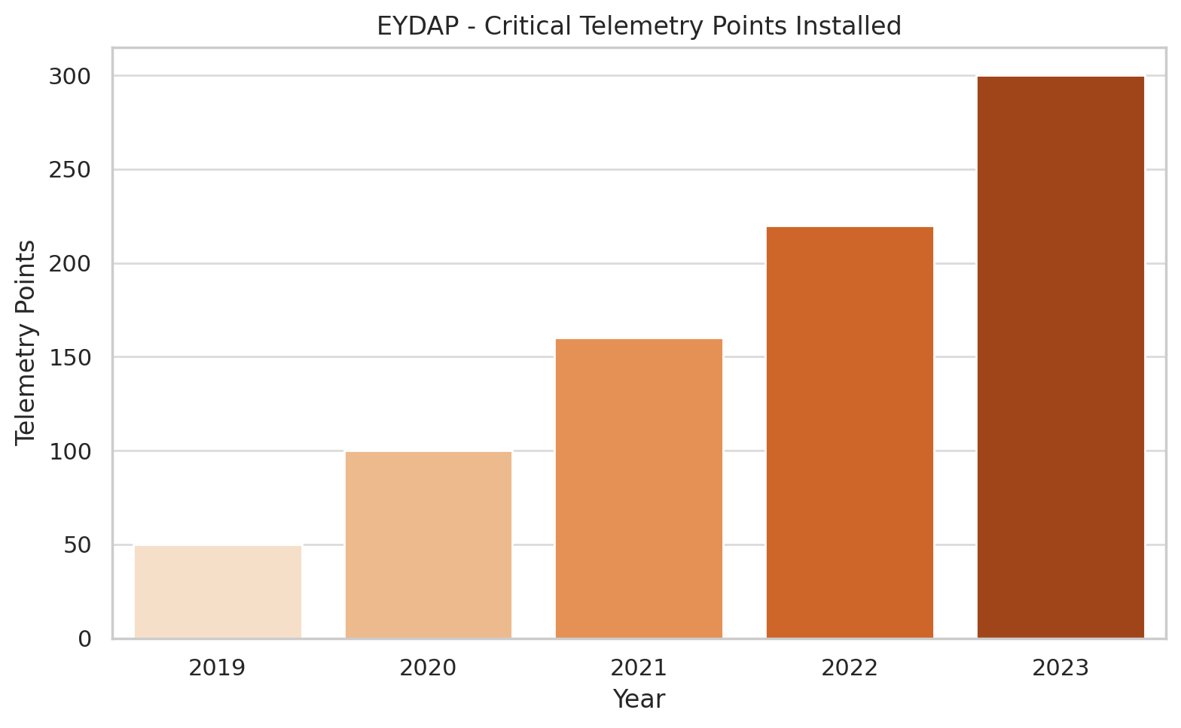
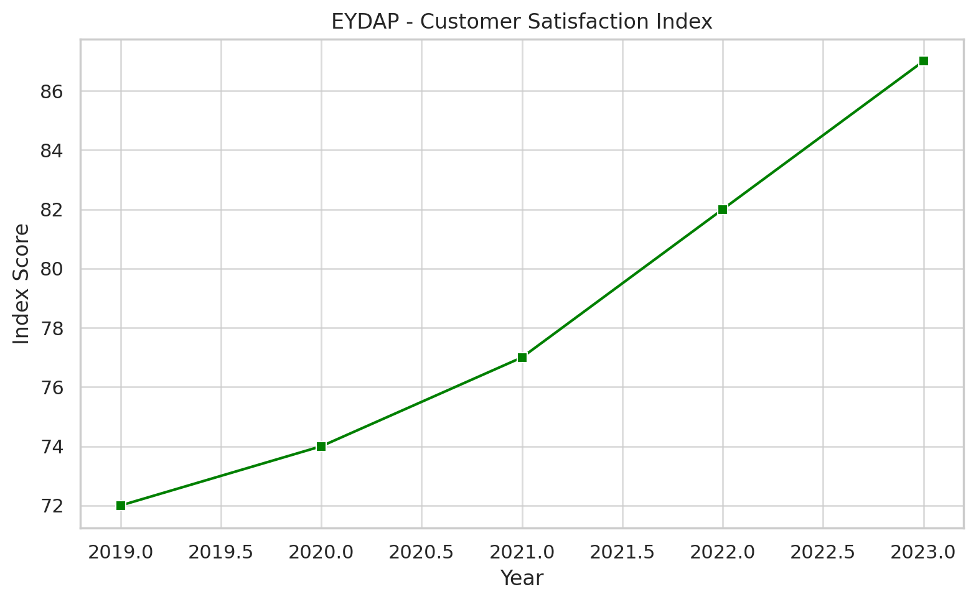
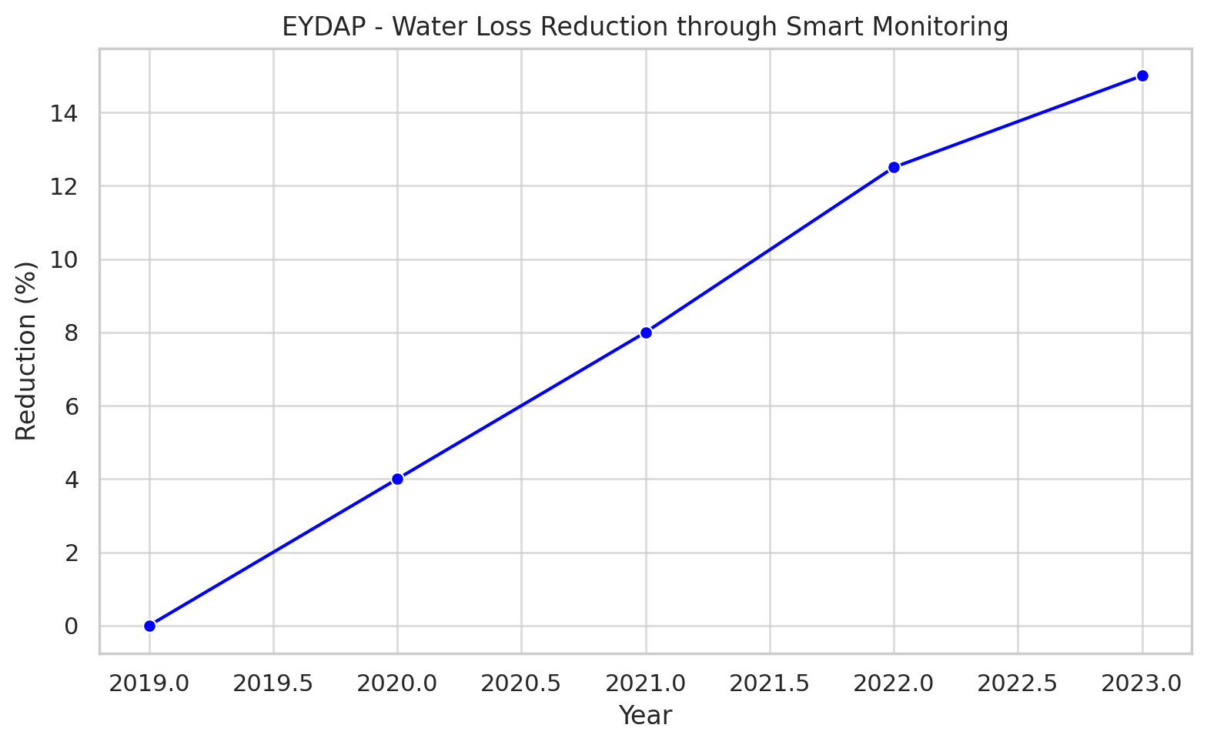
EYDAP (AthensWater Company)
EYDAP (AthensWater Company) deployed 170,000 smart meters and more than 300 telemetry nodes across its water supply network, also the company trained 1,000+ employees annually
Smart Water Meters Installed: A rapid rollout from just 5,000 in 2019 to 170,000 by 2023.
Telemetry Nodes Deployed: Strategic installation of 300+ critical telemetry points to monitor chlorination, flow, and pressure
Water Loss Reduction: Thanks to smart metering and telemetry, network water loss was reduced by 15% between 2019–2023.
Customer Satisfaction Index: Rose from 72 to 87, indicating improved service transparency and responsiveness.
Notes:
“Finally, EYDAP demonstrates Industry 4.0 adoption in the water sector. The company rolled out 170,000 smart meters and over 300 telemetry nodes, reducing water loss by 15% and improving service quality. Customer satisfaction also rose from 72 to 87, while more than 1,000 employees were trained annually. This shows how even public utilities can leverage digital technologies for efficiency and transparency.”

Slide 15
Conclusions (Part A: Technologies & Advantages)
The Smart Factory is not just an upgrade of traditional production, but a redefinition of industrial logic.
With 4 technological pillars, data and connectivity, analytics and intelligence, human–machine interaction, and the transition from physical to digital, a unified ecosystem is created, enabling real-time monitoring, learning, and adaptation.
This leads to:
Operational Efficiency: Real-time monitoring, predictive maintenance, and automation reduce downtime, improve production quality, and lower operational costs.
Environmental Sustainability: Digital tools optimize energy use and minimize waste, helping companies reduce their CO₂ footprint and align with international sustainability goals.
Strategic Competitiveness: The integration of Industry 4.0 strengthens global positioning, enhances innovation capacity, and allows companies to offer flexible, customized solutions.
Human Capital: Smart factories introduce new digital roles and improve safety while also empowering employees through continuous training and upskilling programs.
Notes:
The Smart Factory is more than just an upgrade – it’s a whole new way of thinking about production. It’s based on four pillars—data, intelligence, human–machine interaction, and digital tools—that work together to create a smart, connected ecosystem. This brings better efficiency, greener operations, stronger competitiveness, and new opportunities for workers through training and safer roles.

Slide 16
Conclusions (Part B: Challenges & Workforce Readiness)
While the benefits are clear, the transition to Industry 4.0 is not without obstacles.
High Initial Investments: Significant financial resources are required for infrastructure modernization, digital platforms, and new technologies, which can be prohibitive for smaller firms.
Cybersecurity Risks: Increased digital interconnection exposes industrial systems to cyberattacks, making data protection and secure operations a pressing concern.
Skill Gaps: A large part of the Greek workforce still lacks digital literacy, while education and vocational training are not yet aligned with Industry 4.0 requirements.
Organizational Resistance: Resistance to change, rigid structures, and lack of change management strategies often delay or undermine digital transformation efforts.
Workforce Readiness: Positive examples, such as Papastratos, EYDAP, and Mytilineos, show how structured training and innovation hubs can upskill thousands of employees. However, the absence of a coordinated national strategy limits the scalability of these efforts.
Addressing these challenges requires coordinated policy, targeted investments, and a strong culture of continuous learning.
Notes:
"While the benefits are clear, the transition to Industry 4.0 is not without obstacles, challenges remain. High investment costs, cybersecurity risks, skill gaps, and resistance to change often slow down adoption. The Greek workforce shows both progress and gaps: companies like Papastratos and Mytilineos have trained thousands, but without a national strategy, these efforts remain fragmented. Workforce readiness is the real key to success."

Slide 17
Final Thoughts & Future Outlook
The transition to Industry 4.0 is not simply a technological upgrade, but a strategic necessity for industries seeking resilience, sustainability, and competitiveness.
Smart Factories as a Paradigm Shift: They move production from reactive problem-solving to proactive innovation, where real-time data drives decisions, efficiency is maximized, and sustainability becomes embedded in daily operations.
The Greek Context: Several companies, such as TITAN, Papastratos, and Mytilineos, demonstrate that Greece has the capacity to pioneer digital transformation. Yet, for broader adoption, coordinated public policy, stronger education–industry linkages, and large-scale workforce reskilling are essential.
Global Outlook: Industry 4.0 redefines competitiveness, turning digital readiness into a decisive factor for long-term success. Companies that integrate smart practices will not only achieve efficiency, but also position themselves as leaders in innovation and sustainability.
In essence, the Smart Factory is more than a vision of technology, it is a roadmap for shaping the future of industry, work, and society.
Notes:
"To sum up, Industry 4.0 is not optional — it’s a strategic necessity. Smart factories turn reactive problem-solving into proactive innovation. Greece has success stories, but scaling them requires public policy support, education–industry partnerships, and large-scale reskilling. Globally, digital readiness will define competitiveness, and Greece has the potential to lead if it invests wisely in people and infrastructure."

