Slide 1
Using Monte Carlo simulation to identify safe withdrawal rates in private pension funds
master in business administration
Antonios Dimitriadis
Christos Gkros
Nikolaos Kartalis

Slide 2

Pension Schemes
Factors
Longevity
Ageing population
Defined Benefit | Defined Contribution
Employees pay an amount regularly and expect a defined benefit ( guarantee income for life. An example is the final salary or State Pensions | Employees contribute an amount regularly into a pension pot. Employer may contribute too and State/Govt may offer additional tax benefits. At the end, there is an accumulated pension fund
Employee is passive | Employee is active in retirement decisions and it requires financial education
Responsibility is with employer or State who has to provide the income | Employee is responsible to use the accumulated pension fund to support his retirement
No flexibility, usually nothing left for inheritance | Pension fund belongs to the pensioner and can leave it to family
Source: Canara HSBC Life Insurance
Defined Benefit
Global Trend
Defined Contribution

Slide 3

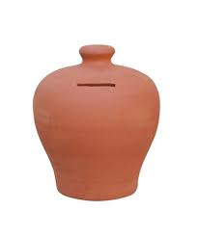
The nastiest, hardest problem in Finance
William Sharpe (winner of the Nobel Prize in Finance in 1990) referred to the decumulation* phase during retirement as the "nastiest, hardest problem in finance."
1. What withdrawal strategy to follow? Fixed or Dynamic?
2. What is the main goal? - High income? Or Leave something as inheritance?
6. What if a financial crisis happen? How is the pension fund impacted?
5. What portfolio should it be used? Equity-based or Balanced?
3. What is the retirement period? (e.g. 30 years?)
4. What is the minimum income and withdrawal rate?
* In accumulation phase employees save in a pension pot and in decumulation phase, when retirement starts, they withdraw money as income

Slide 4

Fixed versus Dynamic Withdrawal Strategy
Fixed Withdrawal Strategy
Withdraw a fixed amount in the first year, and then adjust it with the inflation rate, regardless the portfolio performance
It provides steady income to the pensioners, but it may dilute pension fund earlier, especially if long bear markets occur
Dynamic Withdrawal Strategy
Withdraw a dynamic amount annually based on market performance. For example, we always withdraw 5% of the pension fund annually, based on the value at that specific year.
It provides a dynamic income to the pensioners, which may be higher or lower than then previous year. This may create uncertainty to the pensioners
When portfolio performance is not good, pensioner will withdraw less income protecting the pension fund, but he has to live off with a low income.
A well-known fixed strategy is Bengen’s 4% Rule (1992):
He used a balanced portfolio, US-based.
Proved that the portfolio could survive for 30 years by withdrawing 4% annually and then increase it at the inflation rate
For testing, he used the actual historical data and run back-test for all possible 30 year-periods
Source: Bengen
In this research we tested Vanguard’s Dynamic Spending Strategy with Floor and Ceiling rates (2021) Source: Vanguard
Despite it’s dynamic it tried to provide a steady income to the pensioner
It uses a “floor” limit comparing to the last year’s income when the market performance is negative
It used a “ceiling” limit comparing to the last year’s income when the market performance is positive
For testing, they used their own prediction models for each asset’s return and they applied to their strategy
They used a global balanced portfolio

Slide 5
Testing methodology
Ways to forecast future portfolio returns and validate the strategies:
Use actual historical data
Use different models (researchers, predictive algorithms) to predict expected returns
Use Monte-Carlo simulations
Parameter | Value
Initial Fund Value | 100,000
Withdrawal Strategies | a) Fixed b) Dynamic (Ceiling =5%, Floor=-1.5%)
Retirement Period (5 periods) | 20, 25, 30, 35, 40 Years
Withdrawal Rate (6 for fixed and 8 for dynamic) | Fixed: 2.5%, 3%, 3.5%, 4%, 4.5%, 5% Dynamic: 2.5%, 3%, 3.5%, 4%, 4.5%, 5%, 5.5%, 6%
Inflation Rate | 3% (applicable to fixed strategy only)
Portfolio Performance (2 portfolios for Monte-Carlo) | Equity: Mean=10.46%, SD=18.62% Source: Nasdaq Balanced: Mean=7.16%, SD=6.92%
Monte-Carlo simulations per strategy | 1000 runs
Success Rate for Monte-Carlo simulations | 85% and above (fund to survive for given retirement period)
Assumptions/Limitations | a) We assumed investors could use trackers/ETF, but for simplicity we didn’t consider management fees b) No transaction fees c) Dividend or Capital gain tax was not considered, since this depends on country/personal circumstances

Slide 6
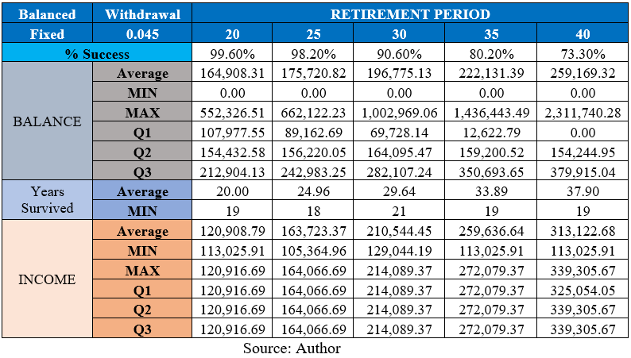
Output from the simulation runs (per case)
Fixed Strategy: Portfolios (2) x Withdrawal Rates (6) x Period (5) = 60 Cases
Dynamic Strategy : Portfolios (2) x Withdrawal Rates (8) x Period (5) = 80 Cases
Total: 140 Cases to be tested
% of times the pension survived until the end
the average balance of the pension fund at the end. This is important when the pensioner wants to leave a legacy as inheritance to his family). It also includes quartiles like Q1, Q2, and Q3 for better representation.
the average years that pot survived and the worst-case scenario (the fastest that pensioner lost all his pot)
Statistics regarding the income (average, min, max, Q1/2/3)
Example: Fixed Strategy, using Balanced Portfolio, WR=4.5%, Period=20,25,30,35,40

Slide 7
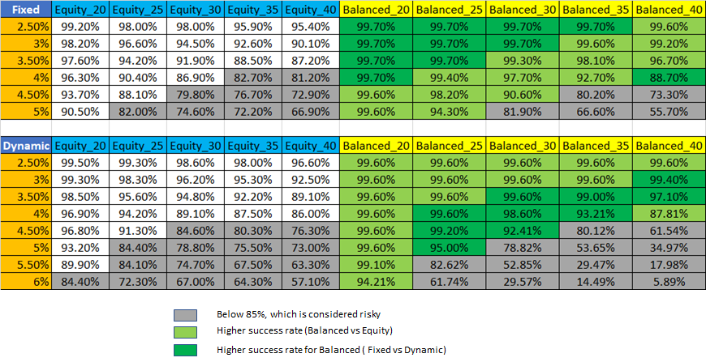
Aggregated Results - Success Rate
Balanced portfolio is “safer” in all cases (Fixed and Dynamic)
Dynamic strategy (with balanced portfolio) performs better in higher withdrawal rates
For equity-based portfolios, the dynamic strategy performed better

Slide 8
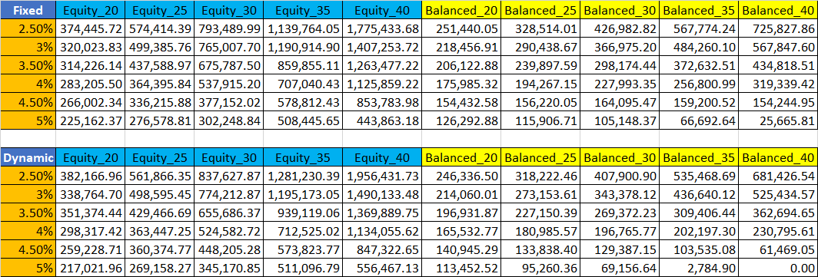
Aggregated Results - Remaining Balance
As expected, the equity-based portfolio offered much higher balances (median) in all the scenarios. Especially for the cases with longer retirement periods, the balance is increasing. Obviously, lower withdrawal rates, will also offer higher balance. The withdrawal strategy, fixed or dynamic doesn’t change the output a lot.
For balanced portfolios, the fixed strategy provided higher balances than the dynamic spending, in all tested scenarios.

Slide 9
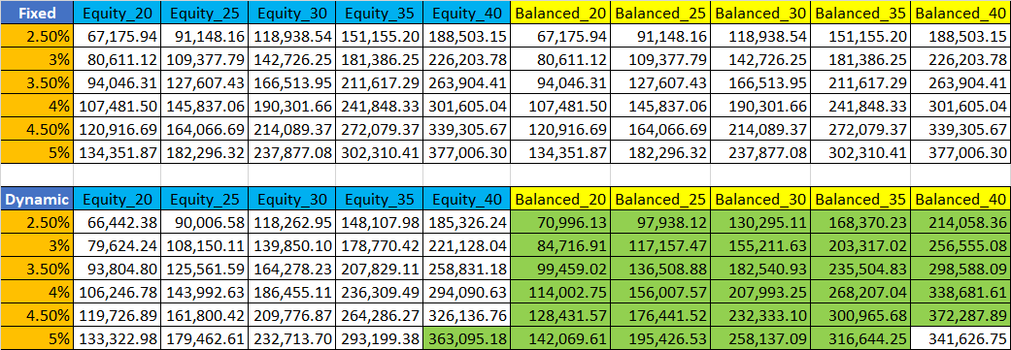
Aggregated Results - Income
For the fixed strategy, there is no difference if the pensioner invested in equities or a balanced portfolio
In the dynamic spending strategy, the balanced portfolio provided higher income (median) in all the cases , due to lower portfolio volatility. It is also the best strategy for income-focus pensioners
For equity-based portfolios, total income is slightly higher in Fixed strategy

Slide 10
Conclusions - Scenarios
Question | Best Strategy
Which strategy, if any, is the best in terms of safety and peer-to-peer comparison? | A balanced portfolio with Dynamic Spending Strategy (any withdrawal rate up to 5%)
What strategy should a conservative pensioner choose for a 30-year retirement period? | A balanced portfolio with Dynamic Spending Strategy with a 4.5% withdrawal rate
Which strategy has the potential to yield a higher remaining balance at the end of life? (while receiving minimum income)? | An equity-based portfolio with Dynamic Spending with a 2.5% withdrawal rate
For individuals planning to retire earlier and requiring funds for a 40-year period or more, which strategy should they pursue? | An equity-based portfolio with Dynamic Spending with a 4% withdrawal rate
Is there a clear winner between the Fixed and Dynamic withdrawal strategies? | Dynamic withdrawal strategy worked slightly better overall
Should individuals opt for a balanced portfolio or an equity-based one? | It depends on the pensioner’s goal: Balanced: worked better in terms of safety and income Equity: worked better for pensioners willing to take higher risks to grow their pension fund (legacy) or plan to retire early (e.g. 40 years)

